Slide 1


Decentralized identity authentication using blockchain and machine learning-based fraud detection
Department of Information Technology
V R Siddhartha Engineering College
Application Area: Blockchain
B.Tech in Information Technology
Major Project Review Presentation
Presented by
Chittiboina Suresh-(228W1A1279)
Ganesh sankar kumar Karanam-(228W1A1295)
Under the guidance of
Dr.S.Jaya Prakash,Senior Assistant Professor

Slide 2
Agenda
Introduction and Problem statement
Objectives and Outcomes of the Project
Literature Review and Summary
Datasets and Requirements
Algorithms used in the Project
Architecture
Implementation steps and execution
Results
Result analysis with charts
Conclusion and future work
References

Slide 3
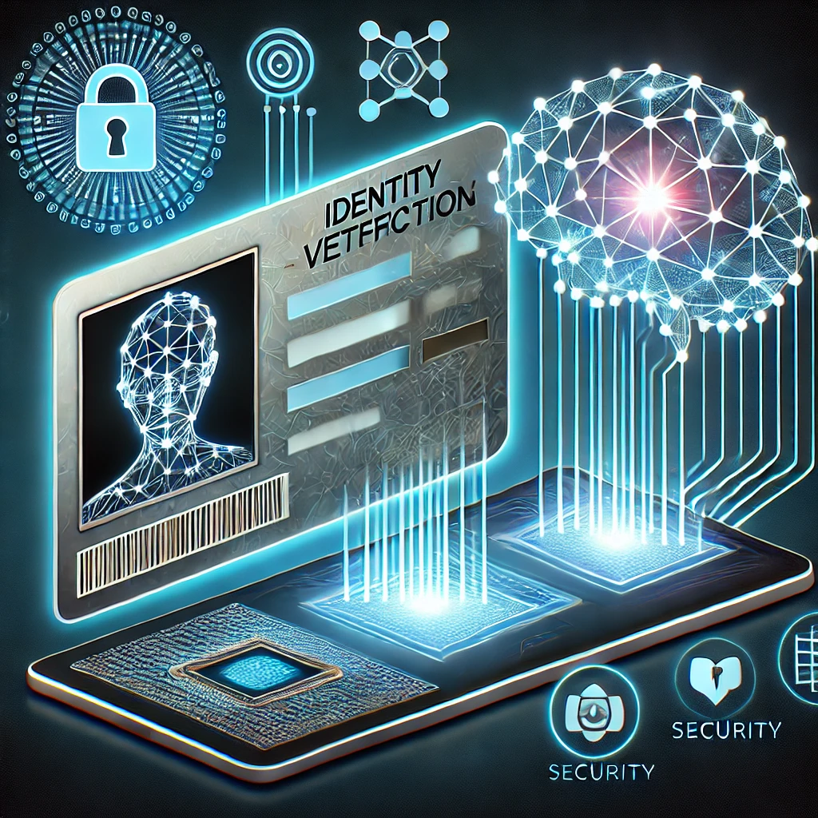
Introduction
In today's digital world, centralized systems often face problems like losing user data and weaker security because they depend on a ‘single point of server’. This makes it easier to access and misuse personal information.
Traditional ways of verifying identities also don’t offer enough ‘transparency’ and are ‘vulnerable’ to hacking.

Slide 4
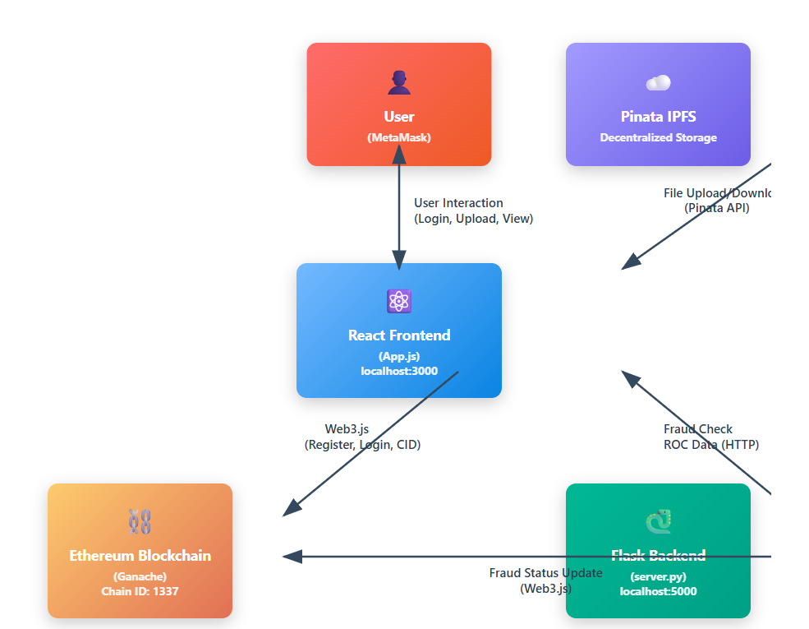
Problem Statement
Existing fraud detection systems are centralized, vulnerable to attacks, lack transparency, and fail to provide explainable decisions. There is a need for a secure, decentralized, intelligent, and real-time fraud detection framework.
Important documents are also at risk of being stolen by attackers, so decentralized IPFS is used to store them.
Machine learning is used to detect anomalous activities to help administrators monitor the system

Slide 5
Objectives and Outcomes of the Project
OBJECTIVES:
Ensure Secure and Identity Management using blockchain technology for immutable and decentralized data storage. Use machine learning algorithms to detect fraudulent behaviour and predict risks.
Continue functioning despite node failures in uploading the files
OUTCOMES:
Enhanced Security – User identity and transaction data remain immutable on the blockchain.
Accurate Fraud Detection – Machine learning algorithms effectively differentiate fraudulent activities from legitimate ones.
Live monitoring of user
Secure file sharing without relying on trusted intermediaries

Slide 6
Literature Summary
S.No | Paper Title | Key Focus | Relevance to Project | Findings & Contribution
1 | Blockchain and AI-Empowered Healthcare Insurance Fraud Detection: An Analysis, Architecture, and Future Prospects | Use of Blockchain & AI for fraud detection in healthcare insurance. | Similar fraud detection principles can be applied to financial transactions to prevent fraudulent activities. | Proposes an AI-blockchain integrated architecture for fraud detection, ensuring security, transparency, and efficiency in fraud prevention.
2 | On the Integration of Artificial Intelligence and Blockchain Technology: A Perspective About Security | AI and blockchain integration with a focus on security aspects. | Highlights how blockchain can secure transaction data and prevent fraudulent modifications, relevant for financial fraud detection. | Discusses blockchain’s role in securing AI-driven systems and preventing fraud by ensuring data integrity.
3 | Survey on Blockchain-Enhanced Machine Learning | How blockchain improves machine learning applications. | Supports the integration of fraud detection ML models with blockchain for secure, tamper-proof predictions. | Explores decentralized ML models, enabling secure fraud detection and data privacy using blockchain.

Slide 7
S.No | Paper Title | Key Focus | Relevance to Project | Findings & Contribution
4 | Integrating Machine Learning and Blockchain for Decentralized Identity Management Systems | Combines ML and blockchain for identity verification and fraud prevention. | user authentication in your project to prevent identity fraud and store verified user identities securely on the blockchain. | Proposes a decentralized identity management system, leveraging ML for anomaly detection and blockchain for secure user identity storage.
5 | SuperCert - An Anti-Fraud Identity Intelligence Blockchain Solution for Educational Certificates | Blockchain-based verification system for educational credentials and IPFS For storage | IPFS for document security. Machine learning for anomaly detection | Integrates IPFS through Pinata service for file storage. Instant verification

Slide 8
Datasets and Requirements:
User activity data and Transaction data:
https://www.kaggle.com/datasets/mlg-ulb/creditcardfraud
https://www.kaggle.com/datasets/goyaladi/fraud-detection-dataset
Requirements:
Blockchain tools:
Platform : Ethereum and Ganache application to deploy the user details, Sepolia Testnet, Alchemy API,Etherscan
Node.js : Truffle Framework tool
IPFS: Pinata API (https://api.pinata.cloud/pinning/pinFileToIPFS), Desktop App (ipfs.io).
MetaMask : transaction of request
Machine learning :
Language : Python
Libraries used : Pandas ,joblib
Model : random forest,Xgboost,LightGBM

Slide 9
Algorithms used in the Project :
Algorithms implemented:
XGBoost Classifier :Optimized boosting model
LightGBM Classifier :Fast and efficient boosting
Gradient Boosting Classifier :Sequential error correction
Random Forest Classifier :Ensemble of decision trees
Logistic Regression :Simple classification model

Slide 10
Pseudocode
1.Start
2.Load dataset
3.Preprocess data (cleaning, splitting)
4.For each algorithm:
Define model
Define hyperparameters
Apply GridSearchCV
Train model
Evaluate performance
5. Compare all models
6. Select best model
7. Make final predictions
8. End

Slide 11
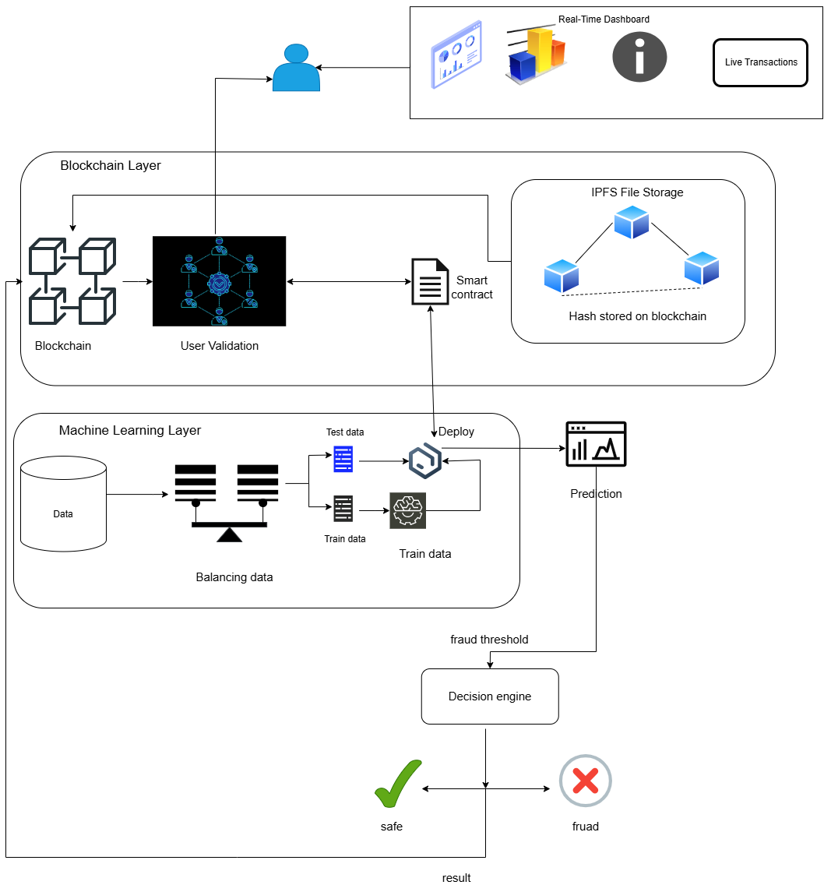
Architecture Diagram:

Slide 12
Implementation steps and Execution
Machine Learning
Step 1: Importing Libraries
-pandas,numpy, scikit-learn
-imblearn.SMOTE, SelectKBest, f_classif
Step 2: Loading of datasets
-Transaction details
-Metadata about transactions
-Customer information
-Fraud labels
-Transaction amounts and anomaly scores

Slide 13
Step 3: Merging Datasets
-Merge the all datasets into single transactions
Step 4: Data Cleaning
-droping the colums TransactionID, CustomerID, Name and address
-filling missing values with zero
Step 5:Encoding Categorical Features
-we convert the textual labels into numeric
-non-fraud=0 and fraud=1
Step 6: Feature Scaling
-we scale the features to have equal weight
z=x−μ​ / σ
Step 7:Handle Class Imbalance
-Using the smote to balance the classes

Slide 14
Step 8:Feature Selection
-We use SelectKBest with ANOVA F-test to select the top 20 most relevant features.
F=betweengroup variance​ /within-group variance
Step 9: XGBOOST, LIGHTGBM
-We use GridSearchCV to find the best hyperparameters.
Prediction=Majority Vote of All Trees
Step 10 :Model Evaluation
-Accuracy,precision,recall,f1 score,ROC-AUC score,confusion matrix

Slide 15
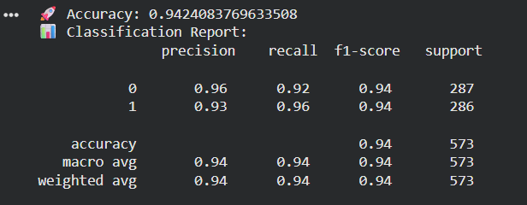
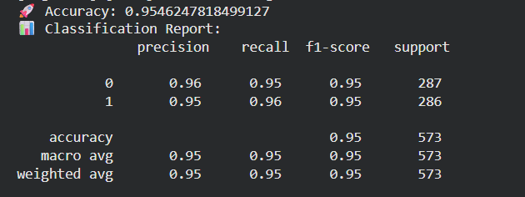
Results :
XGBoost
LightGBM

Slide 16
Results:
Comparison of Machine learning models
Model | Accuracy | Precision | Recall | F1-Score | ROC-AUC
Logistic Regression | 0.586 | 0.583 | 0.601 | 0.592 | 0.623
Gradient Boosting | 0.942 | 0.925 | 0.961 | 0.943 | 0.987
LightGBM | 0.959 | 0.958 | 0.961 | 0.959 | 0.994
XGBoost | 0.954 | 0.948 | 0.961 | 0.955 | 0.992

Slide 17
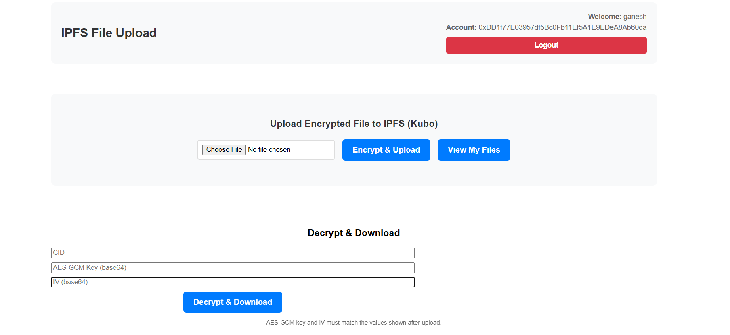

Slide 18
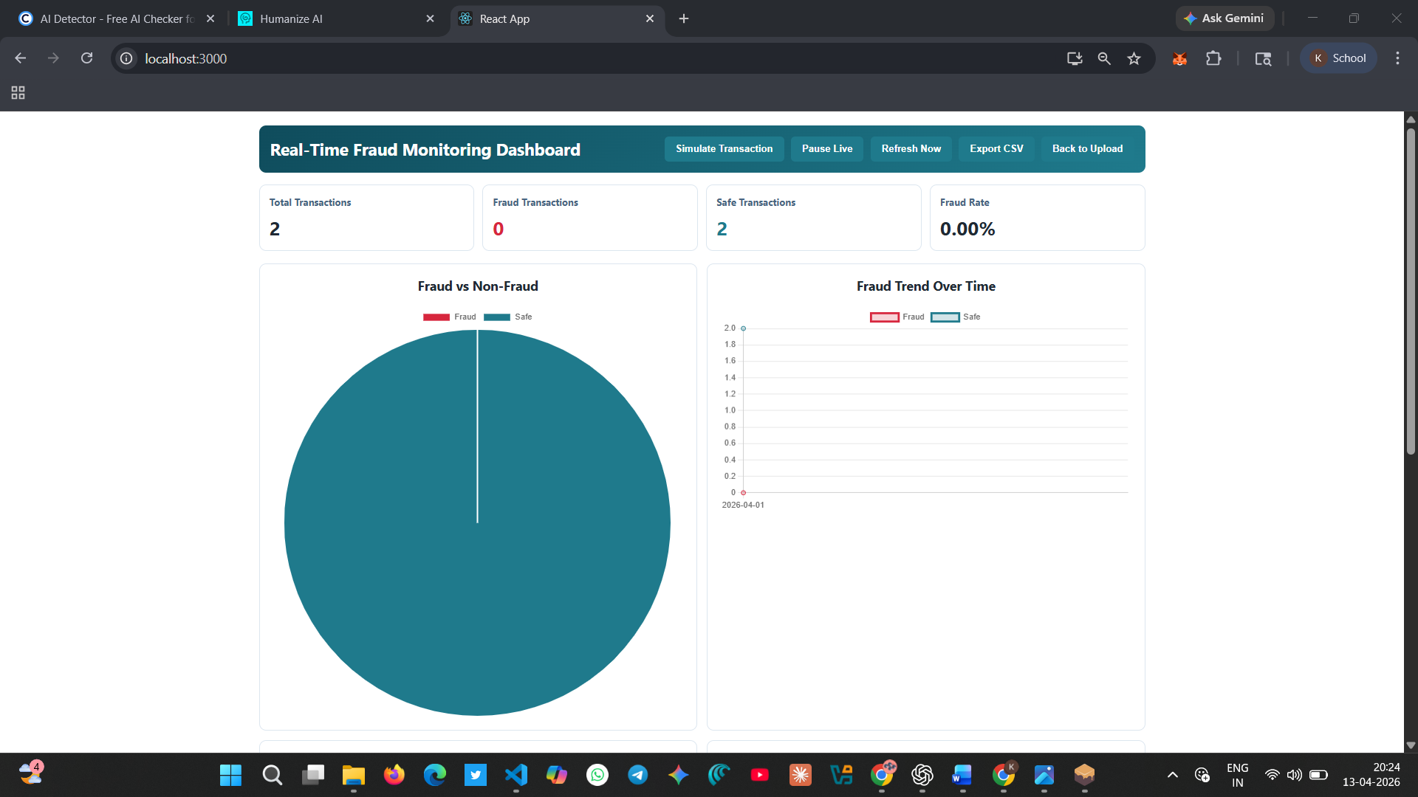
Real-Time monitoring dashboard

Slide 19
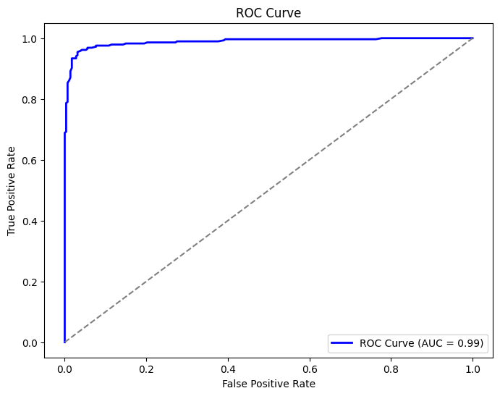
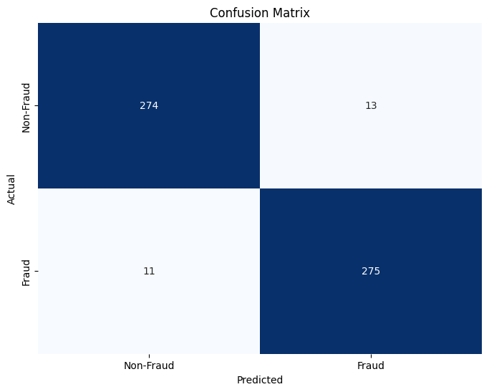
Result analysis with charts :

Slide 20
Conclusion and Future Work :
Conclusion :
Developed an integrated fraud detection system
Compared multiple ML models to improve accuracy
Decision engine improved classification clarity
Blockchain + IPFS ensured secure data handling
Real-time dashboard enhanced monitoring and usability
Deploy system on public blockchain network
Handle large-scale real-time transaction data
Add automated alert and response system
Improve model using deep learning techniques
Enhance dashboard with advanced analytics
Future Work:

Slide 21
References
[1] Alanzi, Haifa, and Mohammad Alkhatib. "Towards improving privacy and security of identity management systems using blockchain technology: A systematic review." Applied Sciences 12.23 (2022): 12415.
[2] Kapadiya, Khyati, et al. "Blockchain and AI-empowered healthcare insurance fraud detection: an analysis, architecture, and future prospects." IEEE Access 10 (2022): 79606-79627.
[3] Kuznetsov, Oleksandr, et al. "On the integration of artificial intelligence and blockchain technology: a perspective about security." IEEE Access 12 (2024): 3881-3897.
[4] Ural, Ozgur, and Kenji Yoshigoe. "Survey on Blockchain-Enhanced Machine Learning." IEEE Access 11 (2023): 145331-145362.
[5] Zheng, Qiuhong, et al. "An innovative IPFS-based storage model for blockchain." 2018 IEEE/WIC/ACM international conference on web intelligence (WI). IEEE, 2018.
[6] Doan, Trinh Viet, et al. "Toward decentralized cloud storage with IPFS: opportunities, challenges, and future considerations." IEEE Internet Computing 26.6 (2022): 7-15

